Slide 1

Those who can not remember the past are condemned to repeat it

Slide 2
Introduction
When the solution can be recursively described in terms of partial solutions, we can store these partial solutions and re-use them as necessary

Slide 3
Example
Let us say that we have a machine, and to determine its state at time t, we have certain quantities called state variables. There will be certain times when we have to make a decision which affects the state of the system, which may or may not be known to us in advance. These decisions or changes are equivalent to transformations of state variables. The results of the previous decisions help us in choosing the future ones.

Slide 4
Fibonacci Series using Recursion
#include<stdio.h>
int fib(int n)
{
if (n <= 1)
return n;
return fib(n-1) + fib(n-2);
}
int main ()
{
int n = 9;
printf("%d", fib(n));
getchar();
return 0;
}

Slide 5
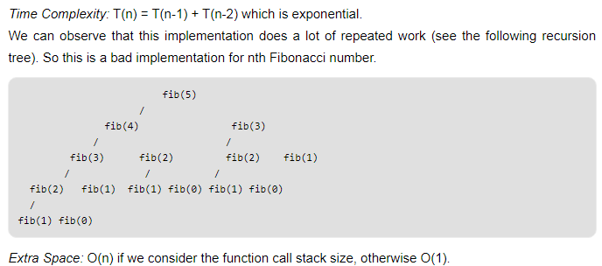

Slide 6
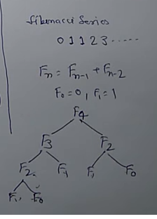
Duplication steps involvement in divide and conquer technique

Slide 7
Dynamic Programming
Dynamic Programming Approaches:
Bottom-Up
Top-Down

Slide 8
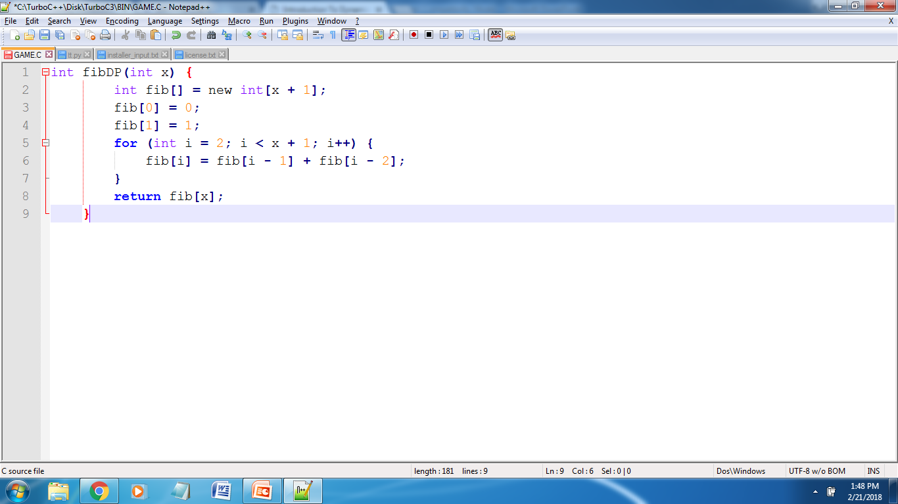
Bottom-Up Approach:
Suppose we need to solve the problem for N, We start solving the problem with the smallest possible inputs and store it for future. Now as you calculate for the bigger values use the stored solutions (solution for smaller problems).

Slide 9
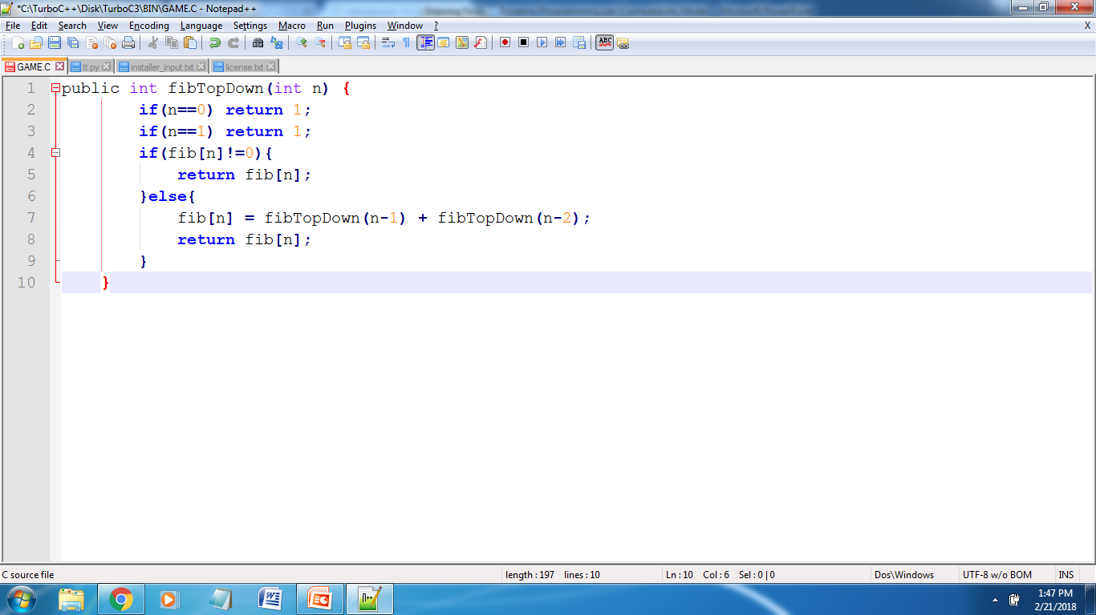
Top-Down Approach
Break the problem into sub-problems and solve them as needed and store the solution for future.

Slide 10
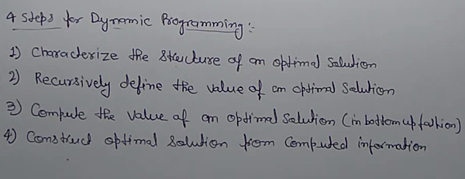

Slide 11
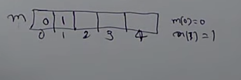
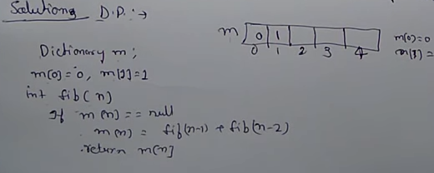
Second Method( Tabulation)

Slide 12
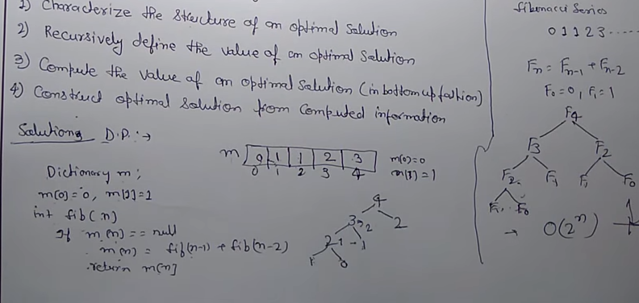

Slide 13
What do we conclude from this ?
We need to break up a problem into a series of overlapping sub-problems, and build up solutions to larger and larger sub-problems. If you are given a problem, which can be broken down into smaller sub-problems, and these smaller sub-problems can still be broken into smaller ones - and if you manage to find out that there are some over-lapping sub-problems, then you've encountered a DP problem.

Slide 14
BOTTOM UP
Analyze the problem and see the order in which the sub-problems are solved and start solving from the trivial sub-problem, up towards the given problem. In this process, it is guaranteed that the sub-problems are solved before solving the problem. This is referred to as Dynamic Programming.

Slide 15
NOTE…..
Note that divide and conquer is slightly a different technique. In that, we divide the problem in to non-overlapping sub-problems and solve them independently,

